Slide 1
Fake Currency Detection
Project Guider: Mr. Emmanuel Preko Boamah
Team Members:
Jacob Mensah
Bright Osei Isaac

Slide 2
Contents
Introduction
Scope and Objective
Problem definition
Existing system
Need for the new system
Proposed system
RList of modules
Description of the first module
References

Slide 3
Introduction
Object recognition is an important and highly demanded area of pattern recognition. An object can be anything in real lifeSimilarly, paper currency recognition is as important as any other object recognition.
In designing such a system, it will consider different dimensions, areas, Euler numbers, and correlations as features. This work will be specifically designed to recognize fake paper currency from real currency in the Republic of Ghana. The proposed scheme will be different from various existing methods because of its ability to use Deep Convolutional Neural Network method on water mark feature in the recognition phases.

Slide 4
Scope and Objective
The objective of this project is to determine whether the currency is counterfeit one or the original one. The term counterfeit money is imitation of the currency produced without the legal sanction of the state or government. Producing or using this fake money is a form of fraud or forgery.

Slide 5
Problem Definition
The Bank of Ghana (BoG) in 2016 narrated the arrest of several corporates in the attempt to produce counterfeit notes into the market. These activities have lead to the lost of several millions of Ghana cedis each and everyday by traders.

Slide 6
Literature survey
Sarfraz (2015) This paper proposes an automatic paper currency recognition system for paper currency. It uses Radial Basis Function Network for classification. The method uses the case of Saudi Arabian paper currency as a model. The system deals with 110 images and had an overall Average Recognition Rate as 91.51%.
Gunaratna, Kodikara & Premaratne (2008) proposed a system that came up with a solution focusing on minimizing false rejection of notes using three layer back propagation neural network. The experiments showed good classification results and proved that the proposed methodology has the capability of separating classes properly in varying images

Slide 7
Literature survey Cont…
Mohammad & Alshayeji(2015) elaborated on a technique for detectin Counterfeit Currency Based on Bit-Plane Slicing Technique. A new approach is discovered in this paper using the bit plane slicing technique to extract the most significant data from counterfeit banknote images with the application of an edge detector algorithm.

Slide 8
Existing System
The existing system of this project used big size counting machines to find the originality of note. These machine comes not handy and often difficult to carry around. The disadvantage of this system is the cost involvement in patronizing the device.

Slide 9
Proposed System
The proposed system uses the Deep Convolutional Neural Network(DCNN) technique of reference note with the testing note. The advantage over the existing system is reducing the external sources and individual user also be aware of the fake notes.

Slide 10
Need For New System
The need for the new system is to detect fake notes which gives the power to a common man to control fake currency circulation in our country and to avoid corruption and also to identify and detect the fake currency easily.

Slide 11
List of Modules
Pre-process
Segmentation
Acquisition
Comparison
Result

Slide 12
Acquisition
The small floral design printed both on the front (hollow) and back (filled up) of the notes in the middle of the vertical band next to the Watermark has an accurate back to back registration. The design will appear as floral design when seen against the light.

Slide 13
Pre-Process:
This module is to process the acquired image from the user for the comparison with the reference image. Initially opencv manager app is needed to install from play store before we run the fake currency detector app. we need to do this because opencv manager is used by application for image enhancement, recognition and tracking.

Slide 14
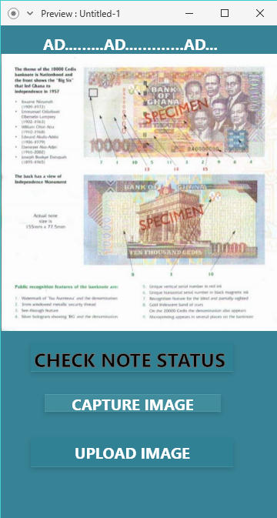
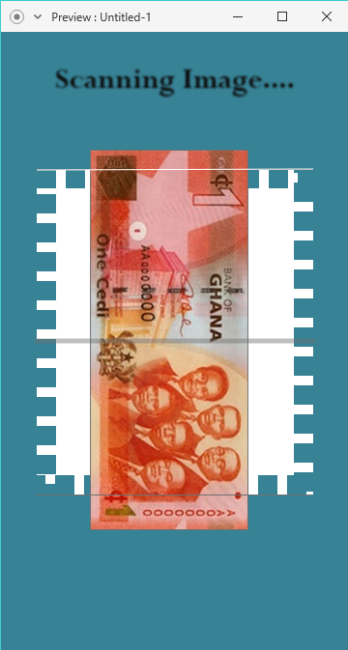
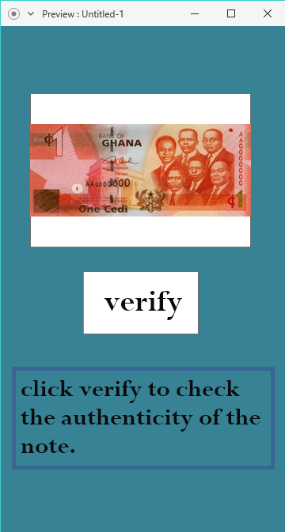
Proposed Interface of the App

Slide 15
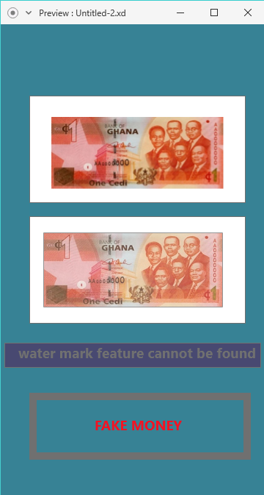

Slide 16
Conclusion
In this work, we demonstrated the feasibility of deploying deep learning techniques for the task of identifying fake currency notes, using the VGG-16 deep convolutional neural network model.

Slide 17
References
Sargano AB, Sarfraz M, Haq N. An Intelligent System for Paper Currency Recognition with Robust Features, Journal of Intelligent and Fuzzy Systems 2014; 27(4): 1905 –1913.
Althafiri E, Sarfraz M, Alfarras M. Bahraini Paper Currency Recognition, Journal of Advanced Computer Science and Technology Research 2012;2(2):104 –115.
Mohammad H Alshayeji, Mohammad Al-Rousan and Dunya T. Hassoun, (2015). Detection Method for Counterfeit Currency Based on Bit-Plane Slicing Technique ,International Journal of Multimedia and Ubiquitous Engineering Vol.10, No.11.
Jiang Wang et al., ”Learning fine-grained image similarity with deep ranking”, Proceedings of the IEEE Conference on Computer Vision and Pattern Recognition, 2014.
Kunze, Ike Sebastian, ”Fine-Grained Image Classification with Convolutional Neural Networks”, Hauptseminar im Wintersemester 2014/15 Medizinische Bildverarbeitung, p.55.
Z. Ge, C. McCool, C. Sanderson, and P.I. Corke., ”Modelling local deep convolutional neural network features to improve fine-grained image classification”, IEEE International Conference on Image Processing,

Slide 18
Thank You!

